Slide 1
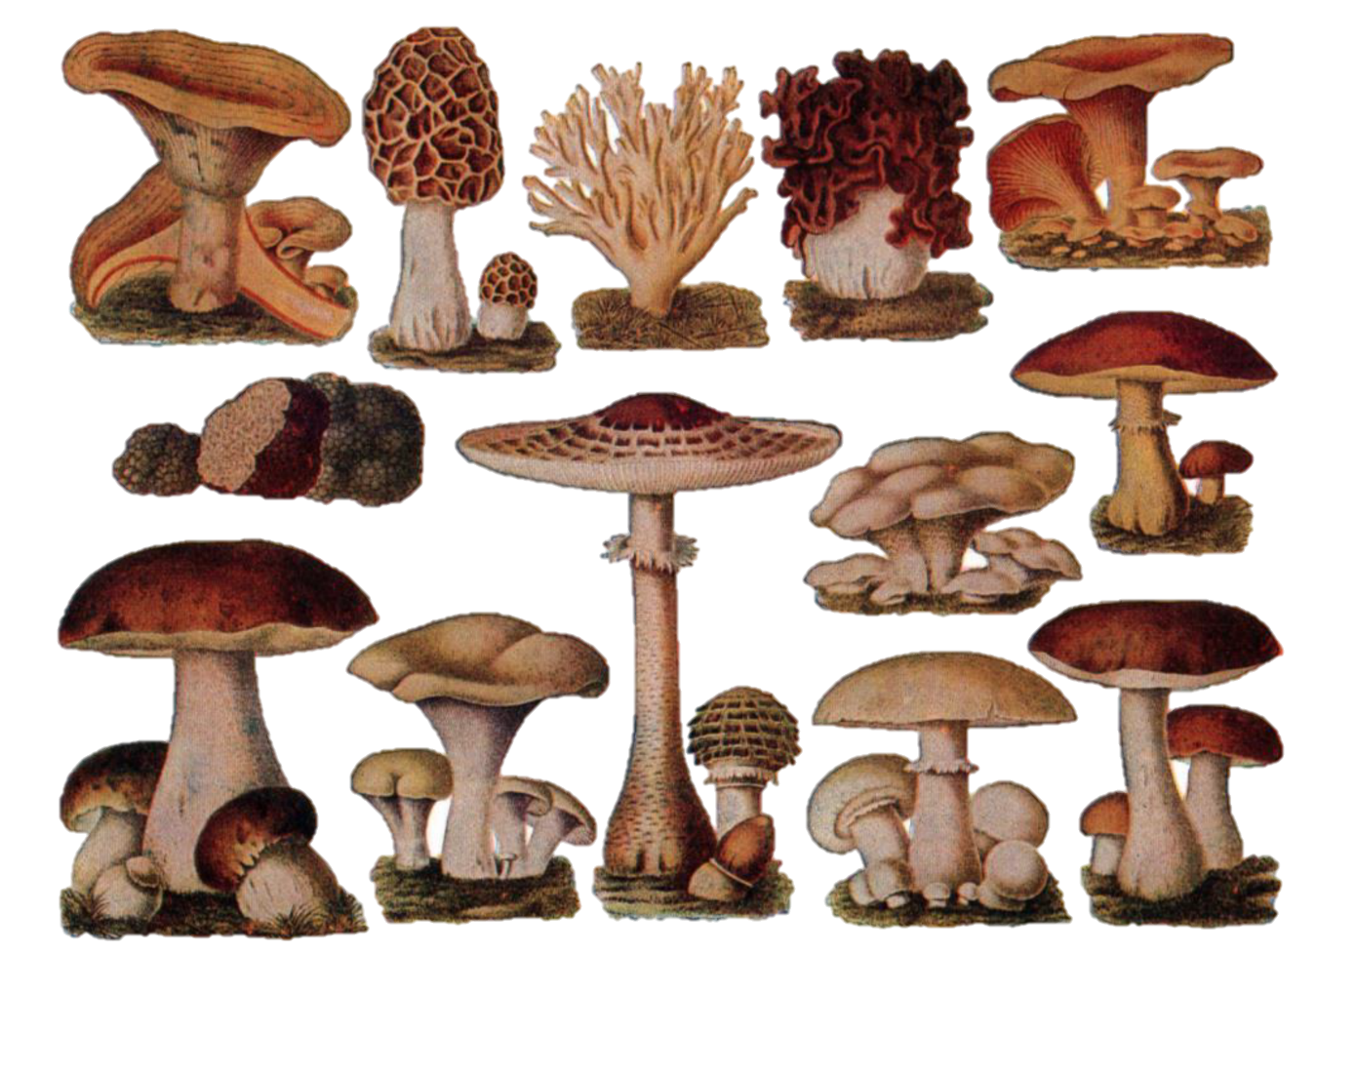
Machine Learning Model to Safeguard Foragers by Distinguishing Poisonous from Edible Mushrooms
Presented By- Krishna Kant Sharma

Slide 2
INTRODUCTION
Mushrooms being the most sustainably produced foods, not only have good taste but also hold a great nutritional value .
Consumption of mushrooms helps to fight different types of diseases such as cancer, helps to regulate blood cholesterol levels, and thus helps to fight diabetes.
But aside from the healthy mushrooms, there also exists poisonous and wild mushrooms whose consumption may result in severe illnesses in humans and can even cause death. It is not easy for a layman to differentiate wild mushrooms from healthy mushrooms . This study aims to classify mushrooms into edible or poisonous using different supervised learning models on the dataset that makes available various specifications of mushrooms like cap shape, cap color, gill color, etc.

Slide 3
OBJECTIVES
The aim is to create a tool that can accurately predict whether a mushroom is poisonous or safe to eat. This tool could be valuable for people who enjoy picking mushrooms in the wild because it adds an extra layer of safety. Instead of relying solely on personal knowledge, they can use this model to make more informed decisions about which mushrooms are likely to be edible and which ones could be harmful.

Slide 4
DATA SOURCE INFORMATION (DATASET-1)
INDEPENDENT VARIABLE
S_no | Field's Name | Description
1 | Cap-diameter | Diameter of the mushroom cap.
2 | Cap-shape | Shape of the mushroom cap.
3 | Cap-surface | The surface texture of the mushroom cap.
4 | Cap-color | The color of the mushroom cap.
5 | Does-bruise-or-bleed | Whether the mushroom bruises or bleeds.
6 | Gill-attachment | Attachment type of the gills.
7 | Gill-spacing | Spacing between gills
8 | Gill-color | Color of the gills

Slide 5
DATA SOURCE INFORMATION (DATASET-1)
S_no | Field’s Name | Description
9 | Stem-height | Height of the mushroom stem
10 | Stem-width | Width of the mushroom stem.
11 | Stem-root | Root type of the mushroom stem
12 | Stem-surface | Surface texture of the mushroom stem.
13 | Stem-color | Color of the mushroom stem.
14 | Veil-type | Type of veil covering the gills (seems to have only one value, which may not provide useful information)
15 | Veil-color | Color of the veil.
16 | has-ring | Whether the mushroom has a ring

Slide 6
DATA SOURCE INFORMATION (DATASET-1)
S_no | Field's Name | Description
17 | ring-type | Type of ring on the mushroom
18 | Spore-print-color | Color of the spore print
19 | Habitat | Habitat where the mushroom is found
20 | Season | Season in which the mushroom is found
TARGET VARIABLE
21 | Class | Target variable indicating whether the mushroom is poisonous ('p') or edible ('e’).

Slide 7
DATA SOURCE INFORMATION (DATASET-2)
INDEPENDENT VARIABLE
S_no | Field's Name | Description
1 | family | To which family they belong
2 | name | Name of the particular species
3 | cap-diameter | Min diameter of the species
TARGET VARIABLE
4 | Class | Target variable indicating whether the mushroom is poisonous ('p') or edible ('e’).
REASON OF NOT INCLUDING THE DATASET-2 FOR THE ANALYSIS:
There is no unique column to merge the 2 dataset
If we know the family and name of the species we can easily identify that the mushroom is poisonous or not , there is no need for model building for the analysis

Slide 8
Step 1
Identify number of missing values from each column and identify columns with a large number of na’s/missing columns
Step 2
Univariate Analysis and Visualization for
each columns in the dataset
EXPLORATORY
DATA ANALYSIS – DATA CLEANING
Step 3
Bivariate Analysis between the columns and Visualization
Step 4
Implementation of feature engineering
Step 5
Implementation of Models

Slide 9
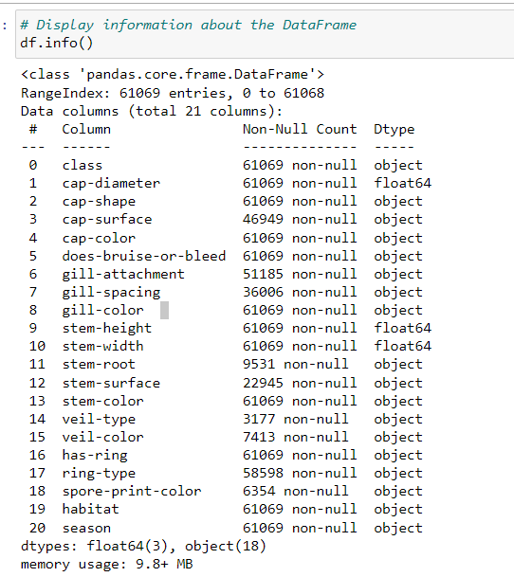
INFORMATION ABOUT THE DATA
17 CATEGORICAL COLUMN
3 NUMERIC COLUMN

Slide 10
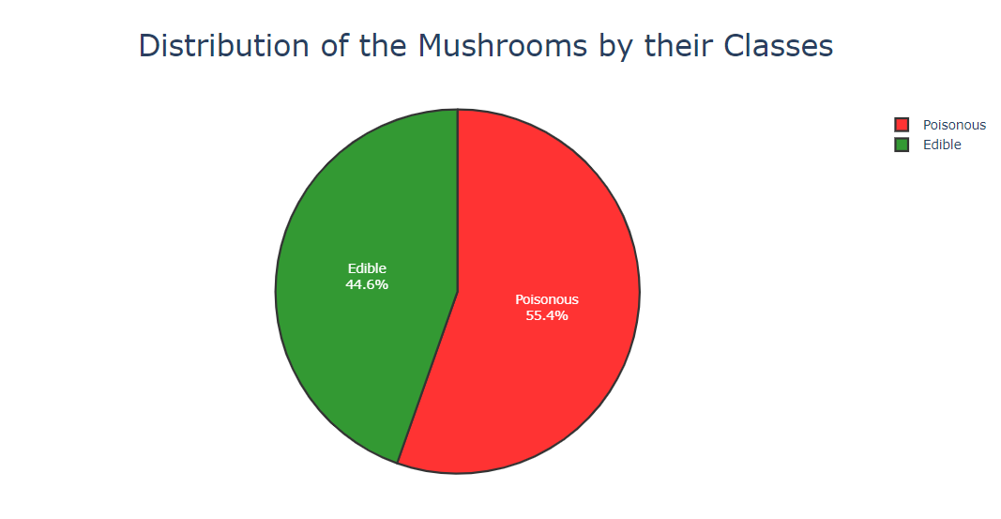
UNI-VARIATE ANALYSIS AND VISUALIZATION
Distribution of the Mushrooms by their Classes
As seen from the figure above,
The red part represents that the percentage of the poisonous mushrooms in the dataset. The green part represents that the percentage of edible mushrooms. The percentages of these classes are pretty close to each other.About 44% are edible and 56% are poisonous,
There is slight imbalance in the dataset
There is no missing values

Slide 11
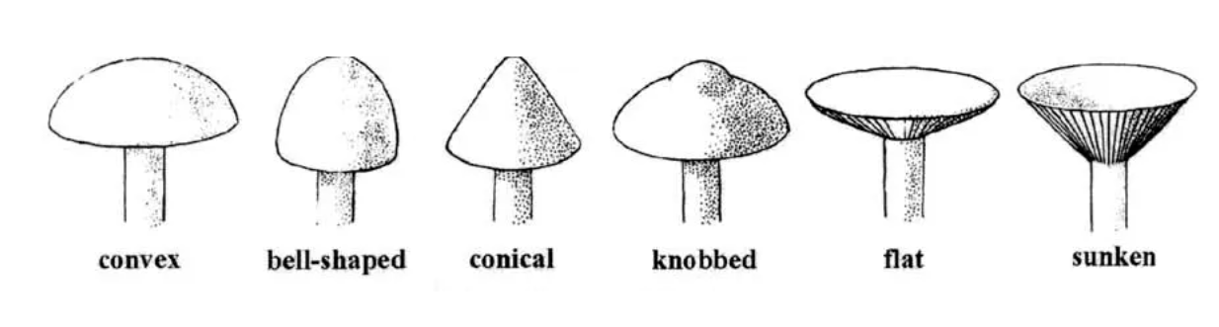
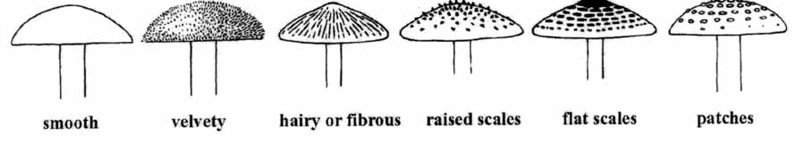
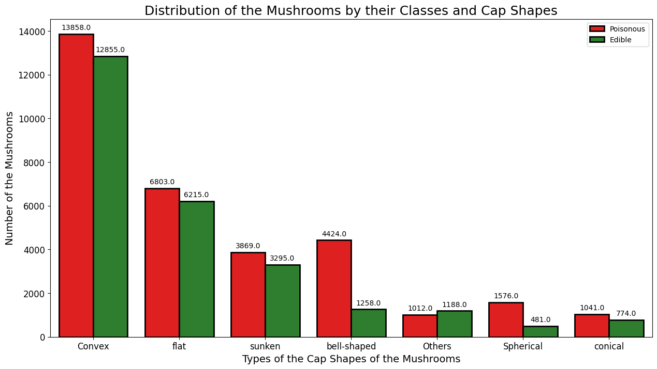
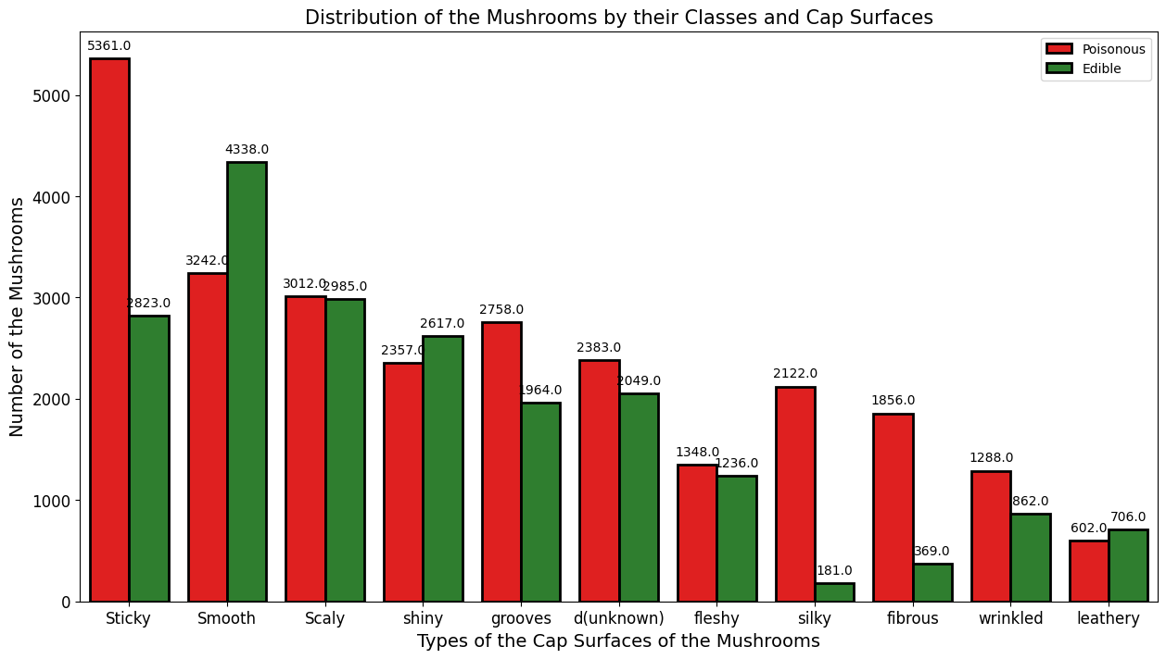
UNI-VARIATE ANALYSIS AND VISUALIZATION
Uni-variate analysis of Cap Shape
Uni-variate analysis of Cap Surface
From the above figure:
Convex cap shapes are most common for both edible and poisonous mushrooms, followed by sunken and bell shapes.
Spherical and conical shapes are less common overall.
No cap shape guarantees edibility
From the above figure :
Sticky caps are the most prevalent type, with over 8196 mushrooms in both edible and poisonous classes followed by smooth and scaly
66% fo Sticky caps are mostly poisonous
If you find a silky cap surface there is 92% chance that the mushroom is poisonous
There is 83% chance that a mushroom having a fibrous cap surface is poisonous

Slide 12
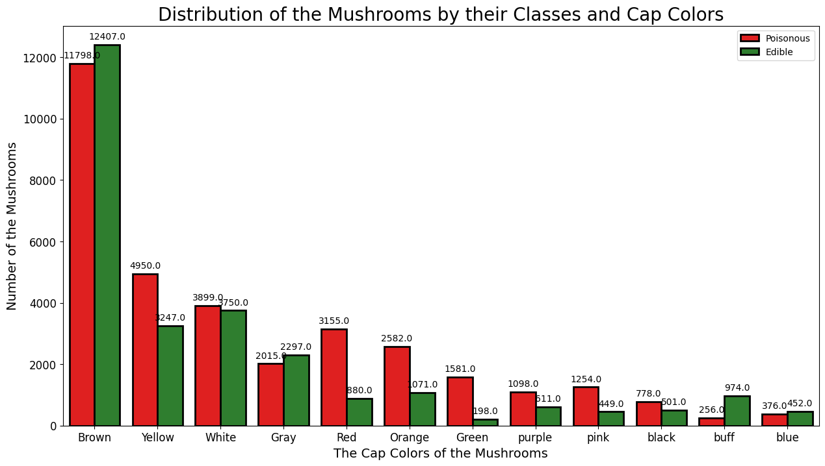
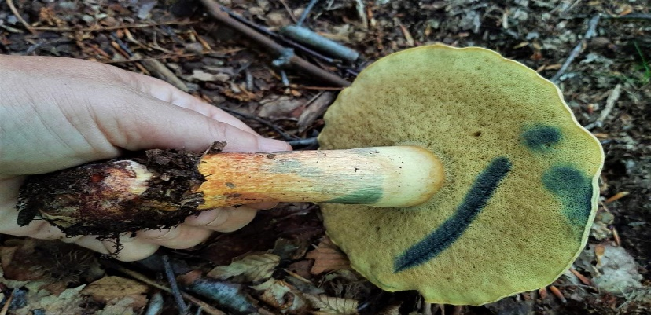
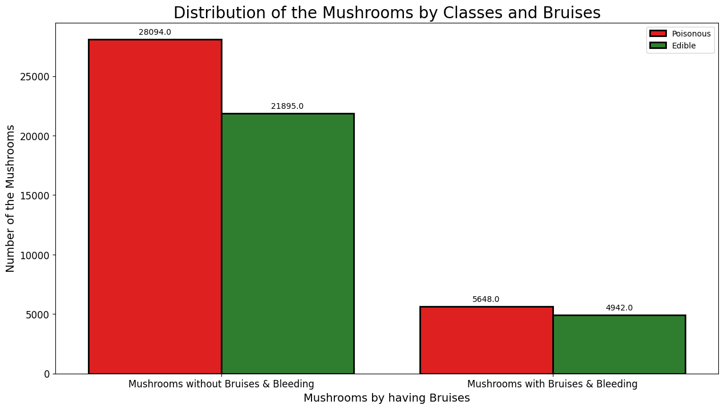
UNI-VARIATE ANALYSIS AND VISUALIZATION
Uni-variate analysis of Cap Color
Uni-variate analysis of Bruises
From the above figure we can see:
1) Brown mushrooms are the most frequent in both classes, followed by yellow and white.
2) purple, pink, black, buff, and blue mushrooms are less common.
3) Mushrooms with brights colors like red, orange,green,pink shows more chance of being poisonous
From the above graph we can see:
About 82% of the mushrooms are without Bruises and Bleeding
The proportion of mushroom with Bruises or Bleeding doesn't determine its edibility or toxicity

Slide 13
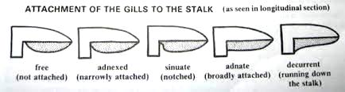
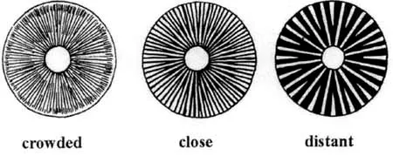
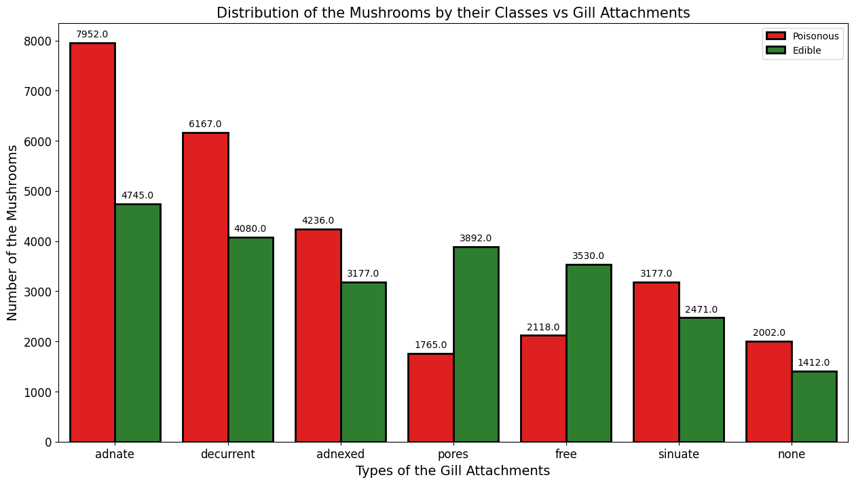
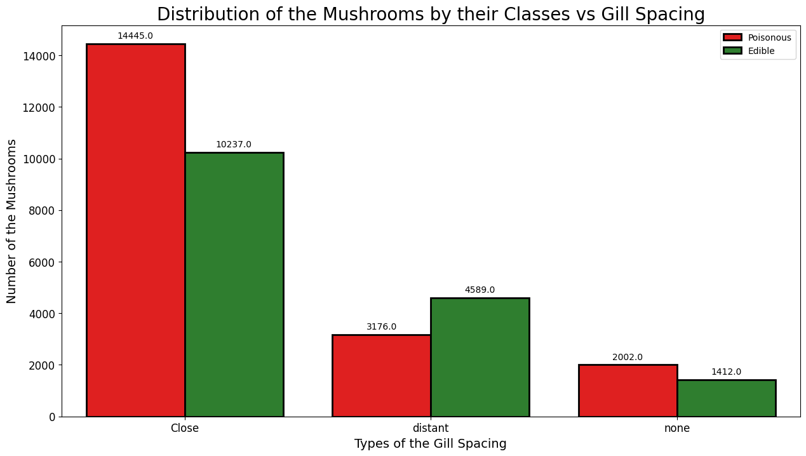
UNI-VARIATE ANALYSIS AND VISUALIZATION
Uni-variate analysis of gill-attachment
Uni-variate analysis of gill-spacing
From the above figure we can see:
1) Most of mushroom have adnate type of gill attachment followed by decurrent and adnexed
2) Adnate and decuurent type of gill attachment mostly determine toxicity in the mushroom
3) Gill attachment having pores are mostly less poisionous
From the above figure we can see:
About 40% of the gill spacing are have close structure
Gill spacing type is almost similar for all classes, close gill type is pretty more poisonous

Slide 14
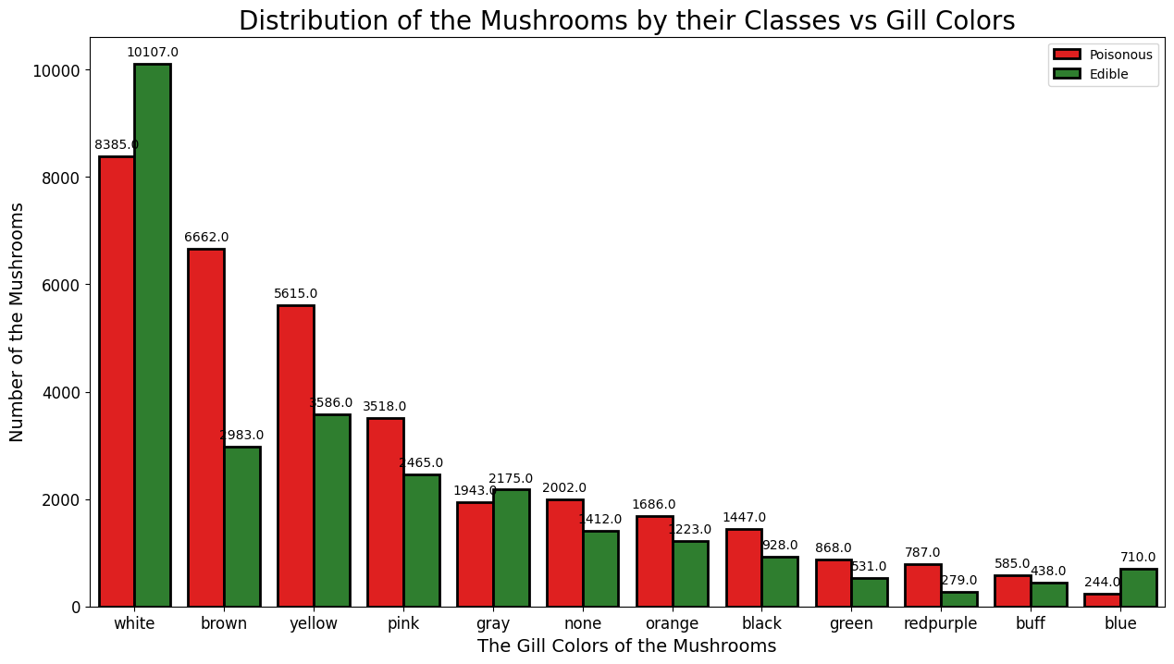
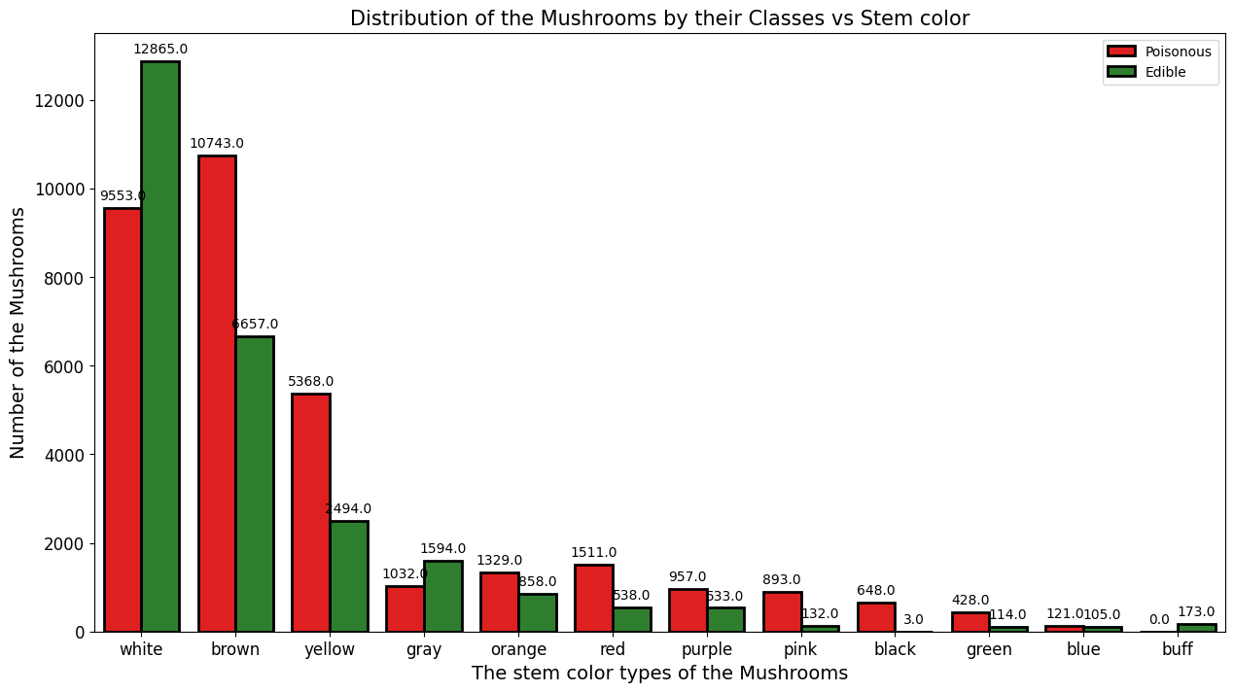
UNI-VARIATE ANALYSIS AND VISUALIZATION
Uni-variate analysis of gill-color
Uni-variate analysis of stem-color
From the figure we can see that:
1) About 30% of the mushrooms have gills with white colors
2) Brown and yellow colors gill mostly determines high chance of toxicity
From the above graph we can see:
white stem color are mostly edible
brown color and yellow color stems are mostly poisionous

Slide 15
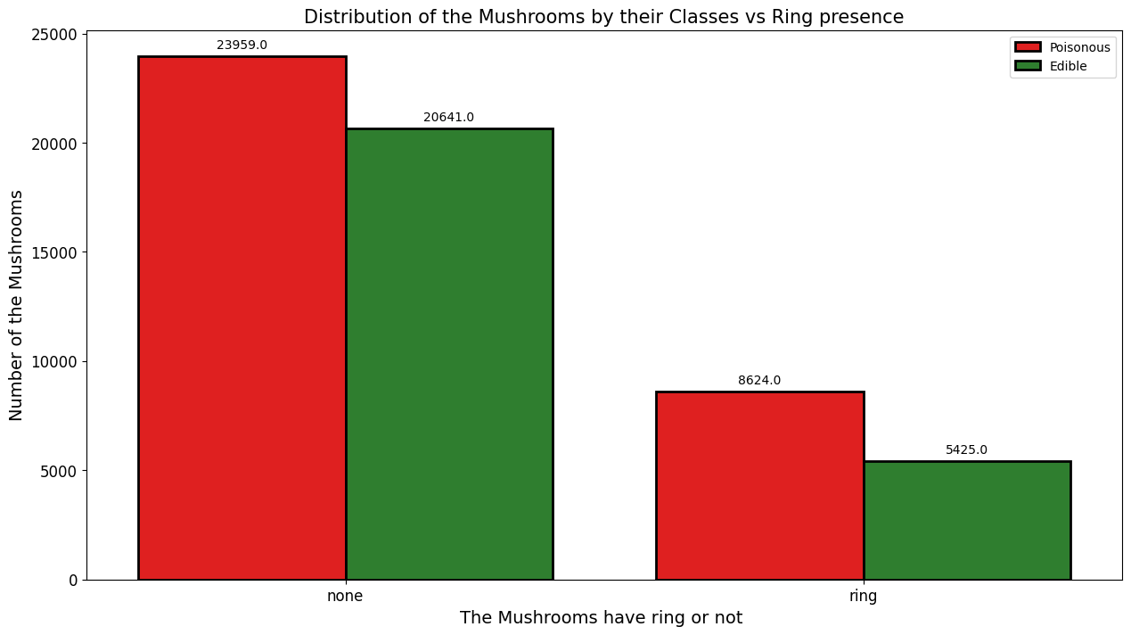
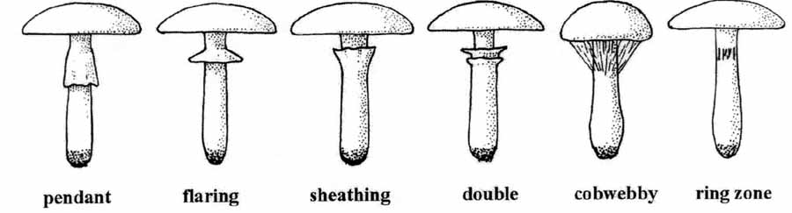
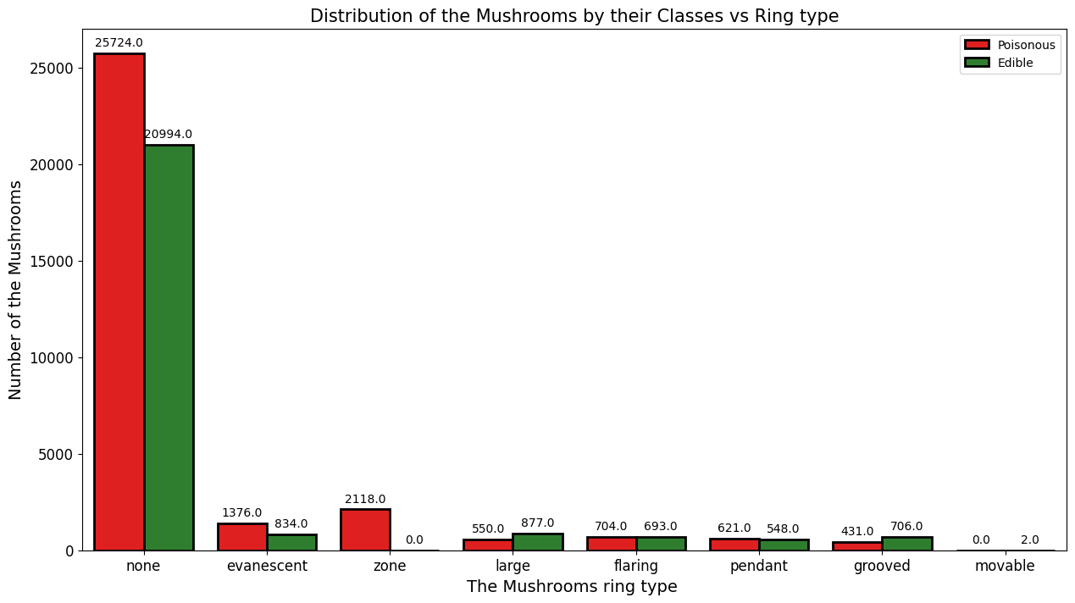
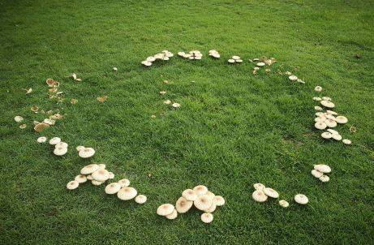
UNI-VARIATE ANALYSIS AND VISUALIZATION
Uni-variate analysis of has-ring
Uni-variate analysis of ring-type
73% of the mushroom don’t have rings
From the above dataset we can see:
About 76% of mushroom have the ring type as none
FAIRY RING

Slide 16
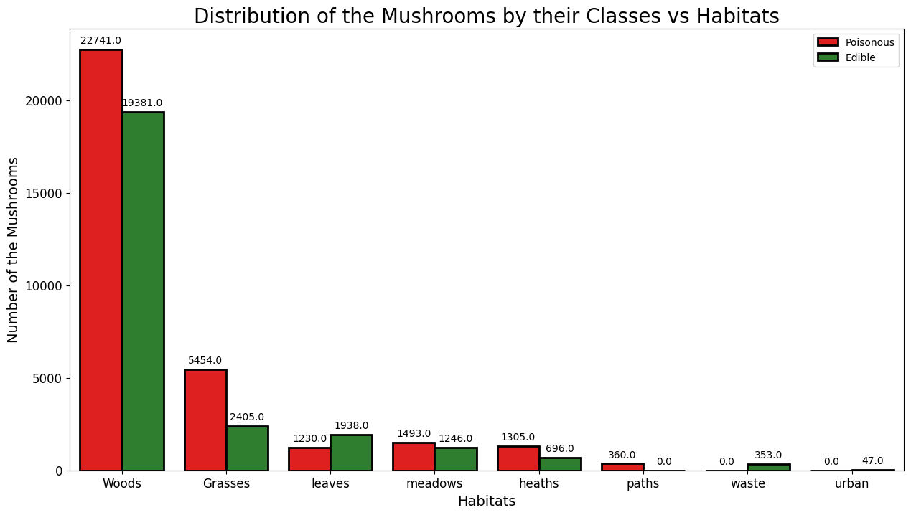
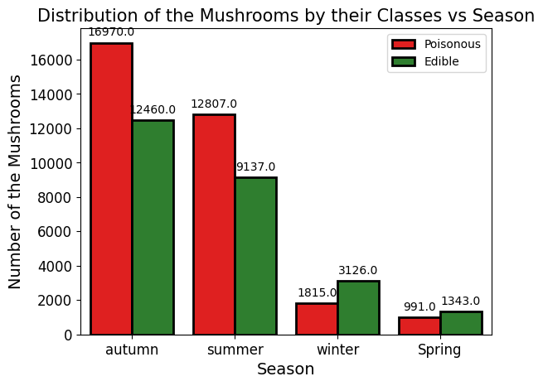
UNI-VARIATE ANALYSIS AND VISUALIZATION
Uni-variate analysis of habitat
Uni-variate analysis of season
From the above graph we can see:
1. Woodland and forest environment provides the best environment where they can thrive
From the above graph we can see:
Mushroom mostly grows in autumn and summer
Mushrooms that grows in winter has less change of being toxic

Slide 17
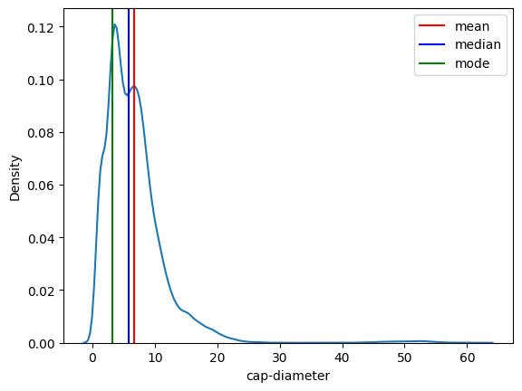
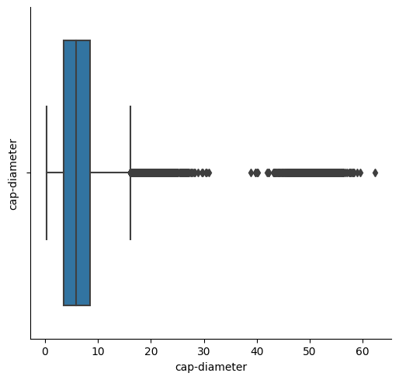
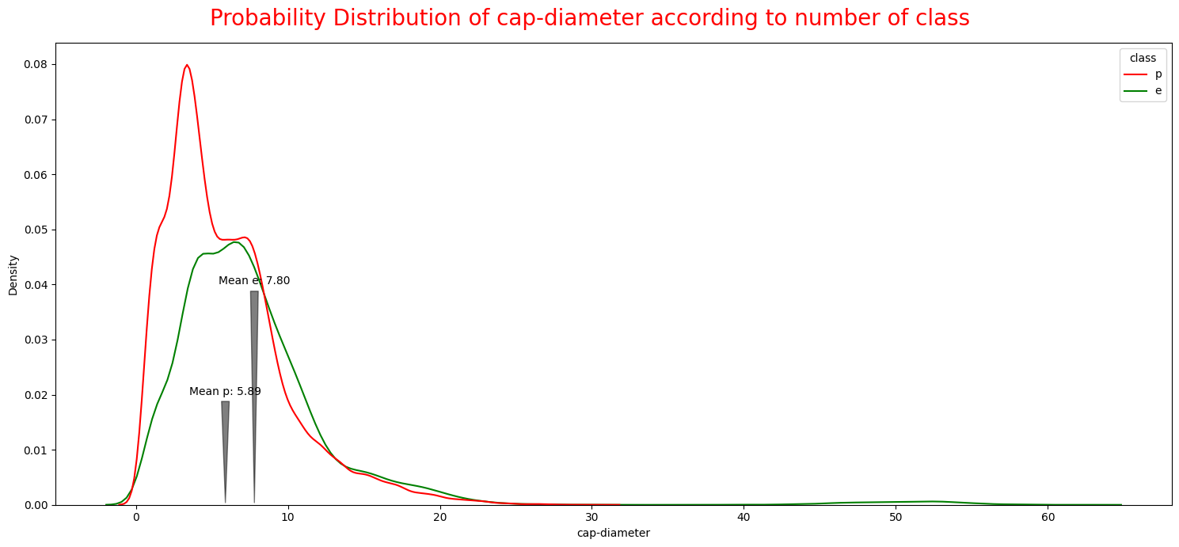
UNI-VARIATE ANALYSIS AND VISUALIZATION
Uni-variate analysis of Cap diameter
Cap diameter is slighty right skewed,
Edible mushroom distribution seems to be more spread out than the poisonous mushroom distribution.
Mean cap-diameter of poisonous mushroom is around 5.88 and for edible is around 7.80, . This suggests that, on average, edible mushrooms have larger cap diameters than poisonous mushrooms.
There is a significant overlap between the two distributions. This means that there are some edible mushrooms with small cap diameters and some poisonous mushrooms with large cap diameters. This highlights the importance of using multiple features for mushroom identification, not just cap diameter.**
Plenty of outliers are there

Slide 18
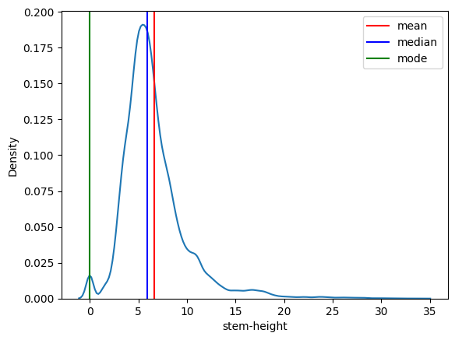
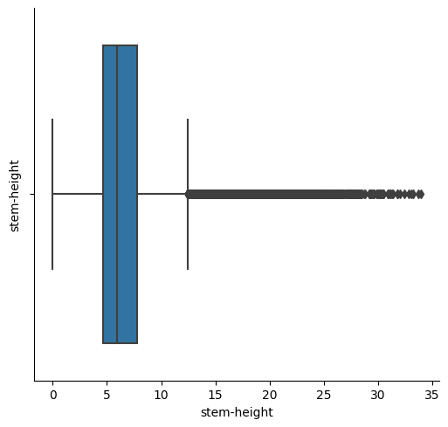
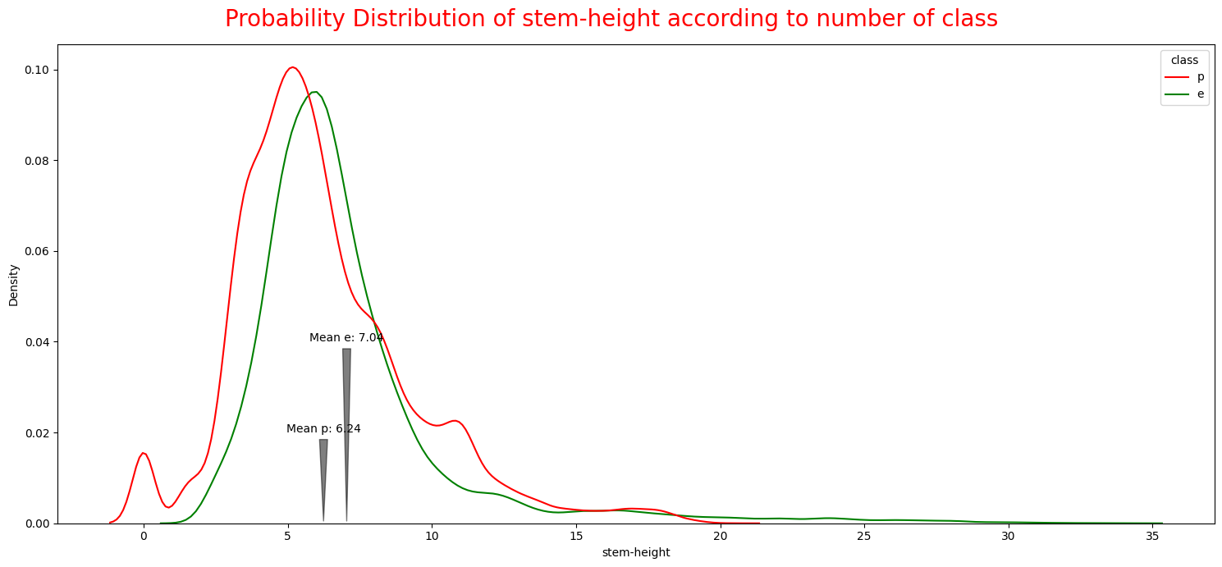
UNI-VARIATE ANALYSIS AND VISUALIZATION
Uni-variate analysis of Stem height
From the image we can see:
1) The green line for edible mushrooms is slightly narrower than the red line for poisonous mushrooms. This means that there is a slightly less range of stem height for edible mushrooms than for poisonous mushrooms.
2) On an average, edible mushrooms tend to have more stems height than poisonous mushrooms.
3) Column contain lots of outliers

Slide 19
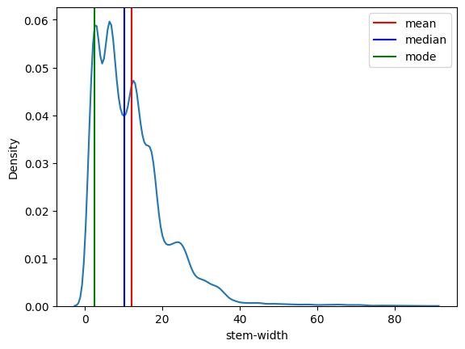
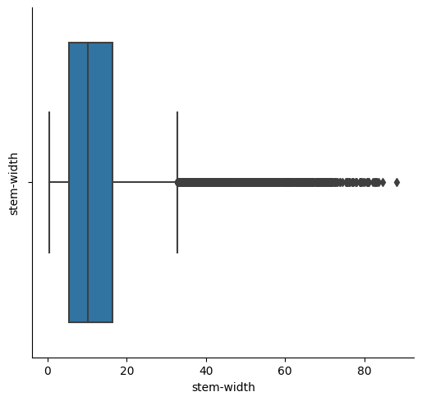
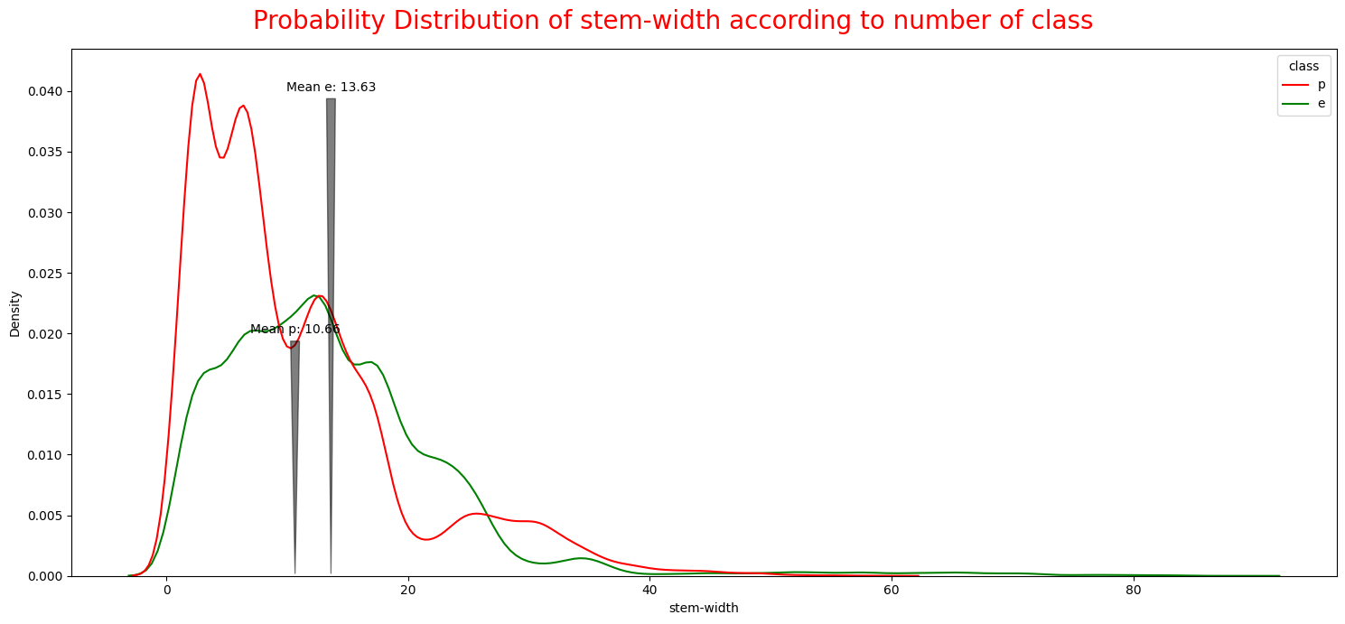
UNI-VARIATE ANALYSIS AND VISUALIZATION
Uni-variate analysis of Stem width
From the image we can see:
1) The green line for edible mushrooms is wider than the red line for poisonous mushrooms. This means that there is a greater range of stem widths for edible mushrooms than for poisonous mushrooms.
2) On an average, edible mushrooms tend to have thicker stems than poisonous mushrooms.
3) On an average poisonous mushrooms tend to have thinner stems than edible mushrooms.

Slide 20
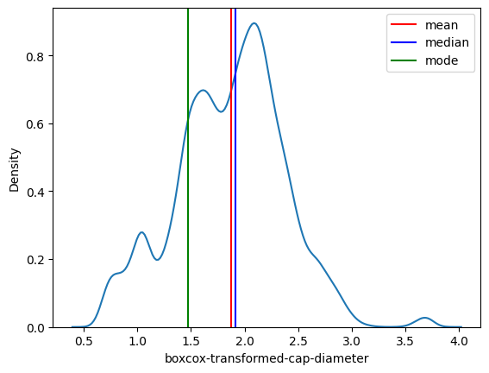
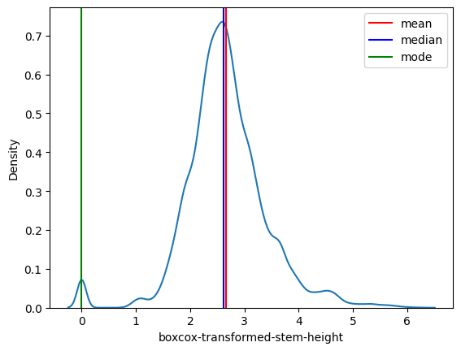
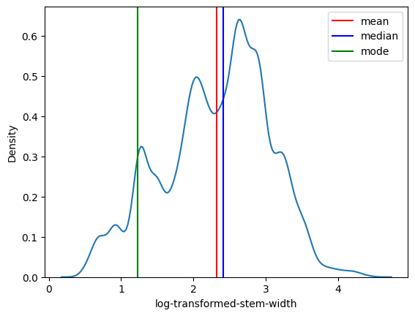
FEATURE ENGINEERING: Column Transformation
Column Transformation of columns: ‘cap diameter’, ‘stem height’ and ‘stem width’ since it contains lots of outliers:
cap diameter
stem-height
stem-width
Box-cox transformed cap diameter
boxcox-transformed-stem-height
Box-cox transformed-stem-width

Slide 21
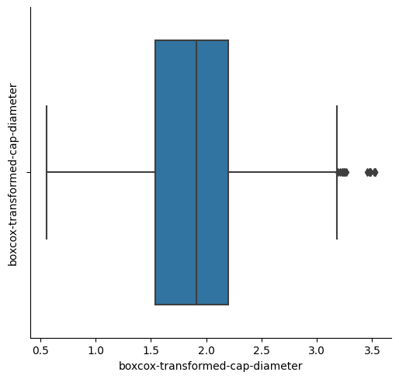
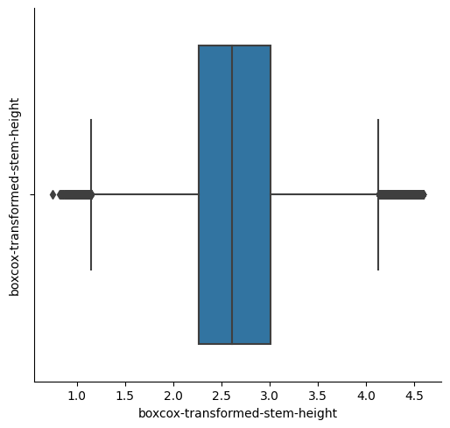
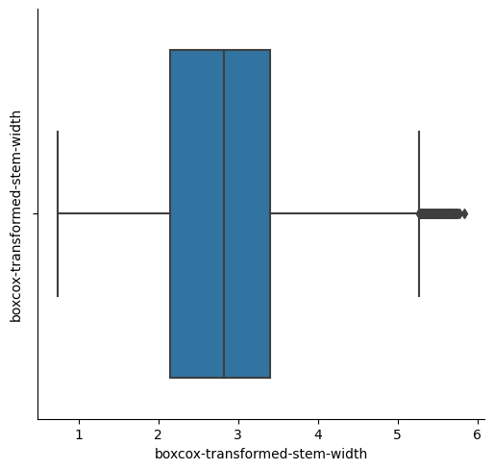
FEATURE ENGINEERING: Column Transformation
Column Transformation of columns: ‘cap diameter’, ‘stem height’ and ‘stem width’ since it contains lots of outliers:
cap diameter
stem-height
stem-width
Box-cox transformed cap diameter
boxcox-transformed-stem-height
Box-cox transformed-stem-width

Slide 22
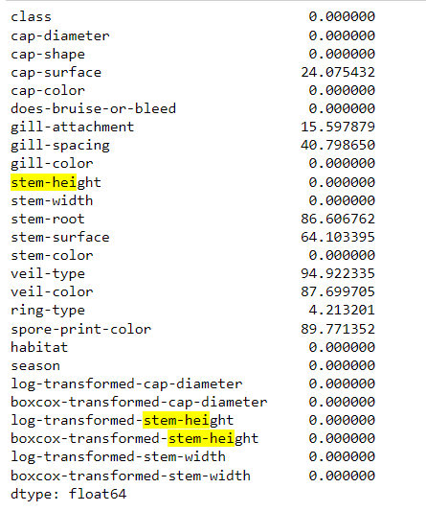
FEATURE ENGINEERING: Missing Values Imputation
Red indicates: High missing values,
Yellow indicates: Moderate missing values
Green indicates: Low missing values

Slide 23
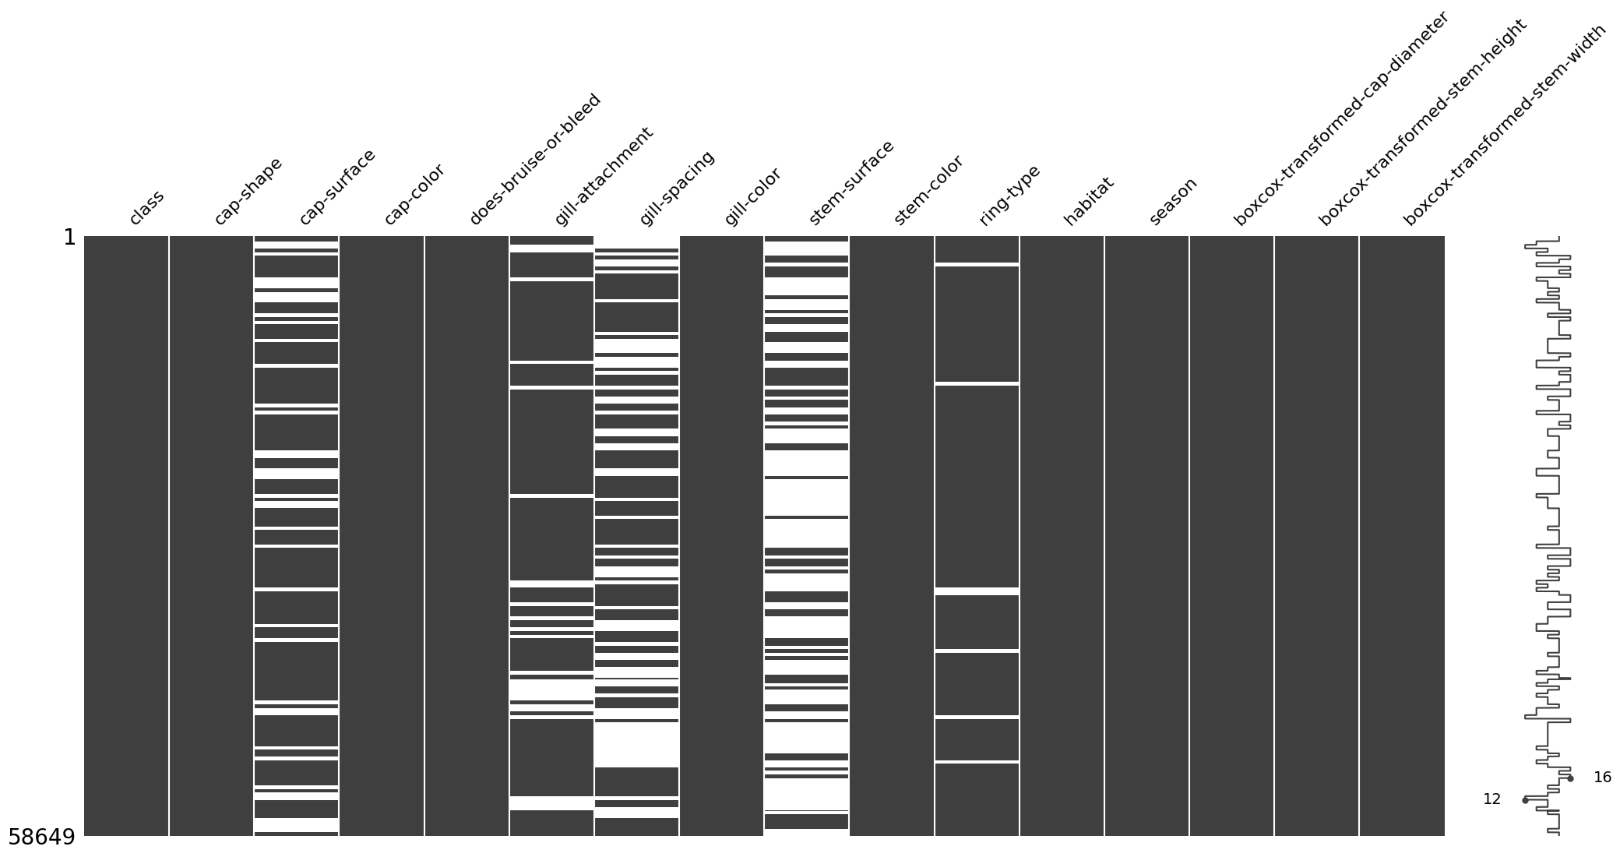
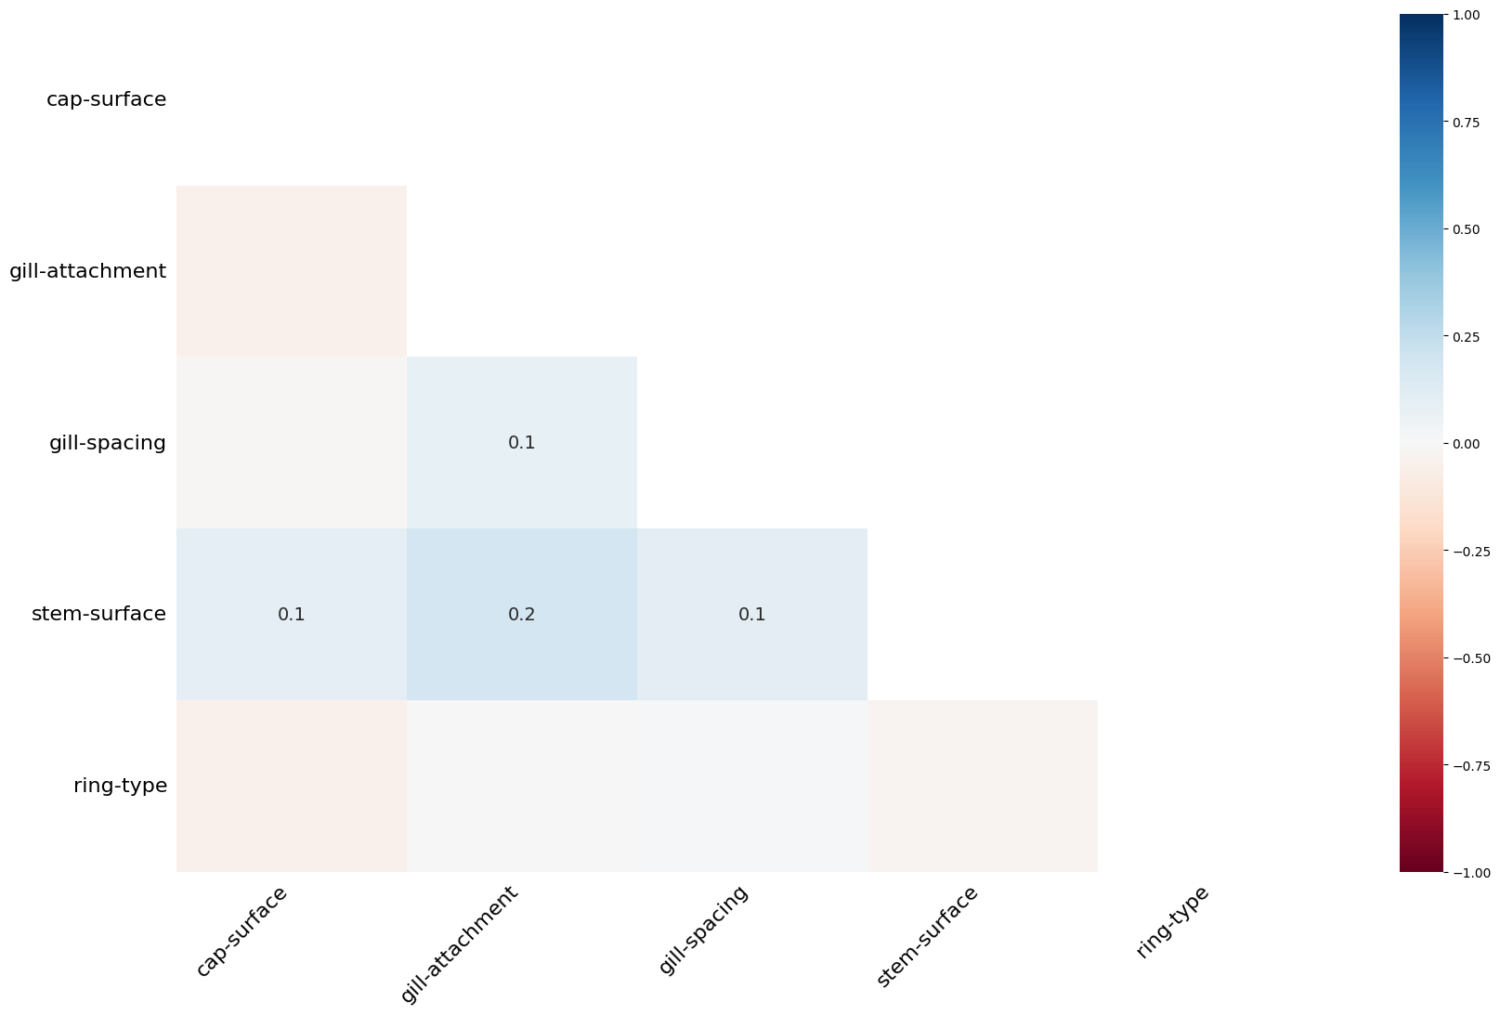
FEATURE ENGINEERING: Missing Values Imputation
Dropping columns: 'stem-root','veil-type','veil-color','spore-print-color','cap-diameter','stem-height','stem-width','log-transformed-cap-diameter','log-transformed-stem-height','log-transformed-stem-width‘ since it contains lots of missing values and outliers
The missing values are Missing Completely at Random (MCAR) for rest of the columns

Slide 24
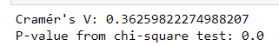
FEATURE ENGINEERING: Missing Values Imputation
using cramar's corelation and chi-square test to test the association and strength of the column gill-spacing & stem-surface with my output variable:
Using cramar's corelation and chi-square test on gill-spacing and class
Using cramar's corelation and chi-square test on stem-surface and class
From the above result: This suggests that there is statistical evidence showing that there is some association between the two categorical variables, but the relationship is very weak
From the above result: This suggests that there is statistical evidence showing that there is some association between the two categorical variables, but the relationship is moderate
Dropping columns: ‘gill-spacing',‘stem-surface since it contains lots of missing values and showing have moderate relationship with the output variable

Slide 25
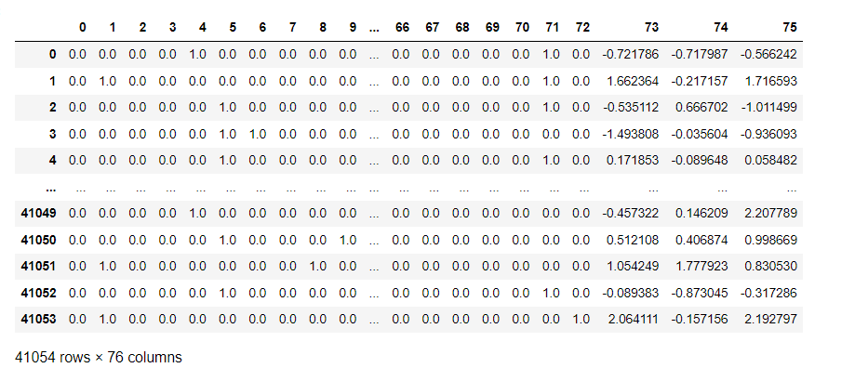
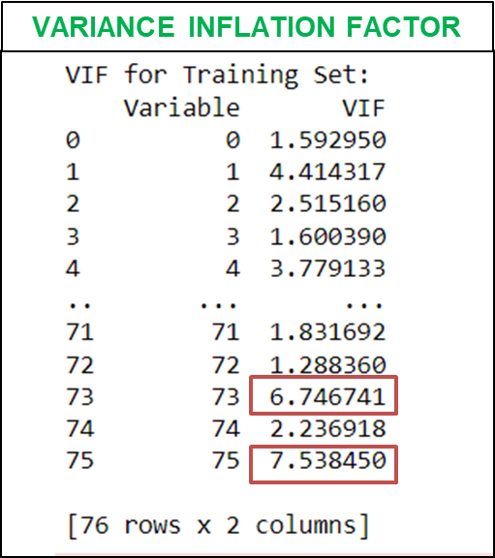
FEATURE ENGINEERING: ENCODING AND STANDARDIZATION
Splitting the dataset between training and testing dataset:
Applying One hot encoding to the columns: 'cap-shape','cap-surface', 'cap-color', 'does-bruise-or-bleed', 'gill-attachment', 'gill-color', 'stem-color', 'ring-type', 'habitat', 'season‘
Applying standardization to the columns: ‘boxcox-transformed-cap-diameter', 'boxcox-transformed-stem-height', 'boxcox-transformed-stem-width'

Slide 26
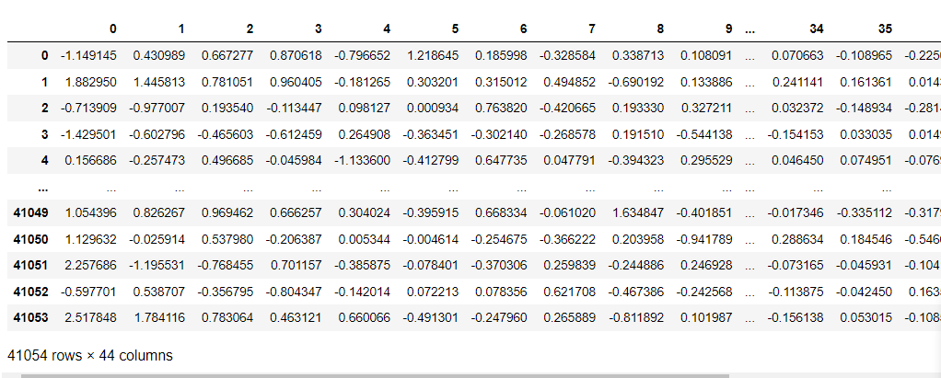
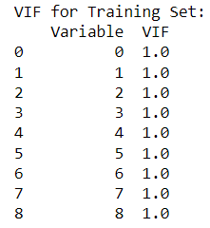
FEATURE ENGINEERING: APPLYING PCA
Applying PCA to reduce the dimensionality and sparsity to avoid curse of dimensionality:
from sklearn.decomposition import PCA
# Step 2: Apply PCA to both the training and testing data
pca = PCA(n_components=.95)
# Fit and transform on the training data
X_train_pca = pca.fit_transform(X_train)
# Transform the testing data using the same transformation parameters
X_test_pca = pca.transform(X_test)
pd.DataFrame(X_train_pca)
VARIANCE INFLATION FACTOR

Slide 27
MODELLING TECHNIQUES USED
Logistic Regression
1) DATA PARTITIONING USED :
70 % training set, 30% validation set – try to account for overfitting of data
SVM
2) FOCUSING ON ACCURACY AND RECALL :
Algorithm will be more preferred which has most accuracy and minimum type 2 error(False Negitive)
3) WE WILL SET OUR ACCURACY AND RECALL LEVEL OVER 99%
KNN
Random Forest

Slide 28
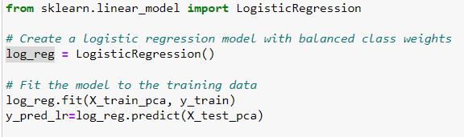
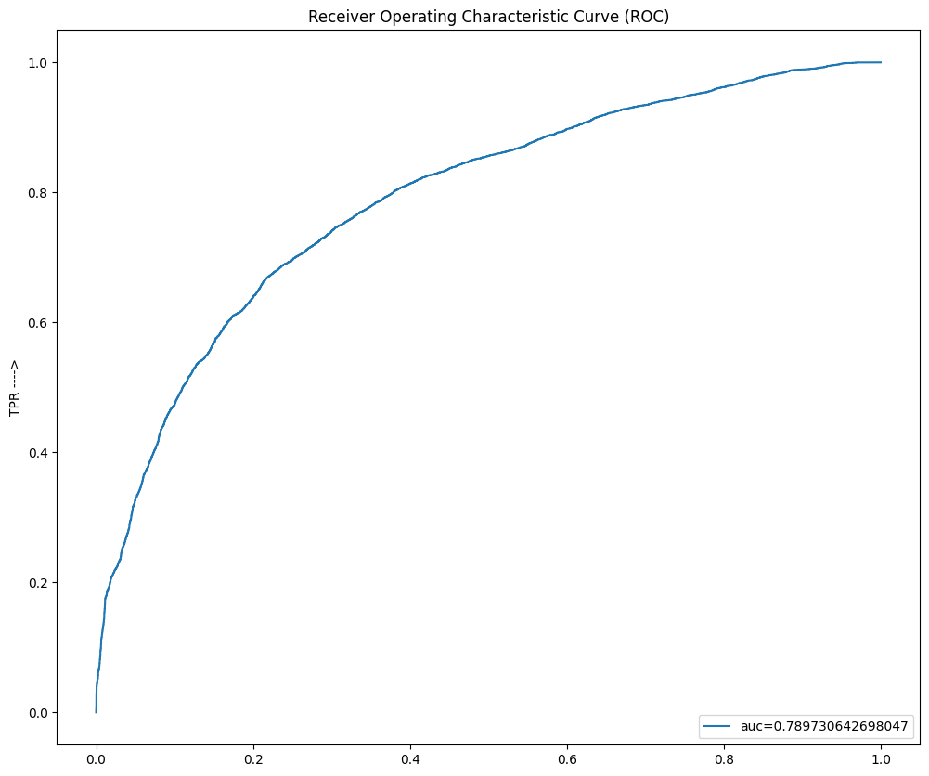
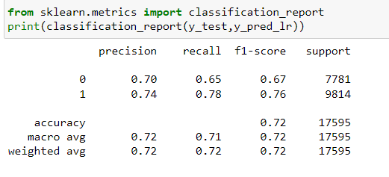
APPLYING: LOGISTIC REGRESSION
AUC: The AUC for this curve is 0.7897, which is a good value. It indicates that the model is performing better than a random classifier.
Distance from the diagonal: The curve is moderately far from the diagonal, which is also a good sign. This suggests that the model is able to discriminate between positive and negative cases better than chance.
Shape of the curve: The curve is relatively smooth and convex, which is a desirable characteristic. This indicates that the model's performance is consistent across different thresholds.
While the TPR is relatively high, the FPR is also non-negligible. This means that the model is making some false positives, which could be problematic depending on the specific application.

Slide 29
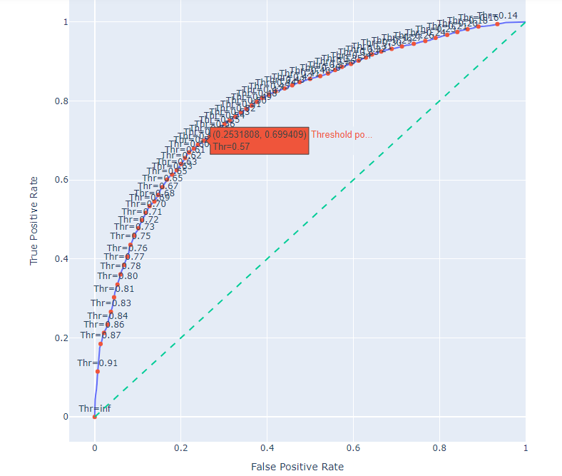
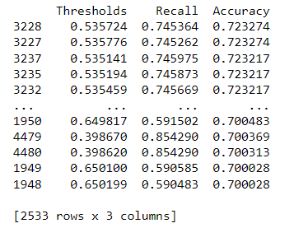
APPLYING: LOGISTIC REGRESSION
Max accuracy achieved is .7233 at a threshold level of .535
Max recall values is .854 at a accuracy of .70

Slide 30




APPLYING: SVM
APPLYING: Naïve Bayes
Applying Cross validation to check for overfitting

Slide 31




APPLYING: KNN
APPLYING: Random Forest
Applying Cross validation to check for overfitting

Slide 32

Result Summary
CONCLUSION:
1) Algorithm like Support Vector Machine, KNN and Random Forest is performing exceptionally well ,
2) My machine learning algorithm doesn’t depend on the a single feature for obtaining 100% accuracy and recall
3) From the confusion matrix, we saw that our train and test data is balanced.
4) Most of classification methods hit 100% accuracy with this dataset.
5) In future we can integrate the model with computer vision and cnn to identify the edibility of mushroom in real time

Slide 33
THANK YOU

